Slide 1
STA457 Midterm test

Slide 2
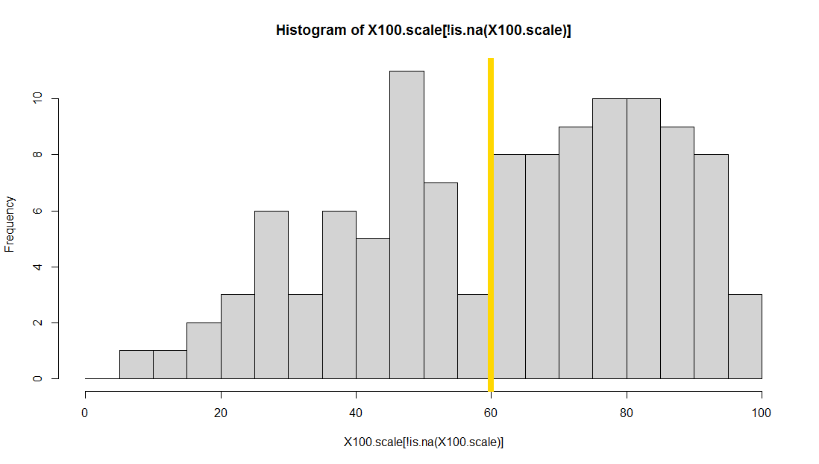
Histogram

Slide 3
100 points scale
Undergraduate
Min. 1st Qu. Median Mean 3rd Qu. Max. NA's
7.50 47.50 67.50 63.23 82.50 100.00 16
Standard deviation 22.59
60+ 70+ 80 + 90+
57.52% 43.4% 26.5% 9.7%
3 students got 100 points
Graduate
Median Mean Max. NA's
87.5 77.88 100.00 2
Standard deviation 25.39
4 students got 100 but 5 students below 85 (13 total)

Slide 4
Proposal to discuss in class
New weighting schemes for undergraduate
Scheme One: 40% midterm and 60% final exam
New scheme two:
Scheme Two-option 1: 10% midterm and 90% final
Scheme Two-option 2: 5 points (out of 40) added to all students
The final mark of this course will be capped at 100
Max (Scheme one, Scheme Two)
Discuss graduate student project on Wednesday
Causality analysis and Transfer function noise modeling
Two in a group

